Slide 1


Sai Charan Mekala
July 2023

Slide 2

Outline
Executive Summary
Introduction
Methodology
Results
Conclusion
Appendix

Slide 3
Executive Summary
Summary of methodologies
This project follows these steps:
Data Collection
Data Wrangling
Exploratory Data Analysis
Interactive Visual Analytics
Predictive Analysis (Classification)
Summary of all results
This project produced the following outputs and visualizations:
Exploratory Data Analysis (EDA) results
Geospatial analytics
Interactive dashboard
Predictive analysis of classification models

Slide 4
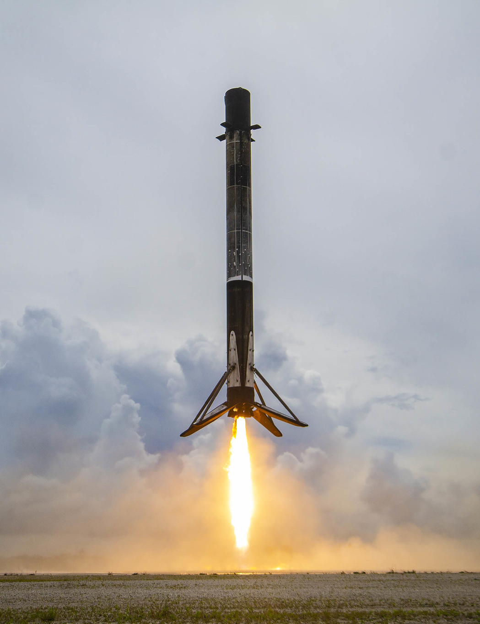
Introduction
Falcon 9 rocket launches by SpaceX cost about $62 million. This is significantly less expensive than other providers (which typically cost more than $165 million), and a large portion of the savings are attributable to SpaceX's ability to land and reuse the rocket's first stage.
We can calculate the cost of a launch if we can determine whether the first stage will land or not.
This project is focused on building a machine learning model to predict if the SpaceX Falcon 9 first stage will land successfully.

Slide 5

Section 1

Slide 6
Methodology
Executive Summary
Data collection methodology:
Using SpaceX REST API
Web Scraping
Perform data wrangling
Using .value_count() method to determine the following:
Number of launches per each Launch sites
Number and occurrence of each Orbit
Number and occurrence of mission outcome per orbit type
Create a landing outcome label from Outcome column
Perform exploratory data analysis (EDA) using visualization and SQL
Perform interactive visual analytics using Folium and Plotly Dash
Perform predictive analysis using classification models
Using Scikit-Learn to:
Pre-process (standardize) the data
Split the data into training and testing data using train_test_split
Train different classification models
Find hyperparameters using GridSearchCV
Plotting confusion matrices for each classification model
Assessing the accuracy of each classification model

Slide 7
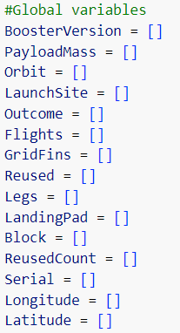
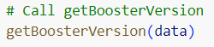
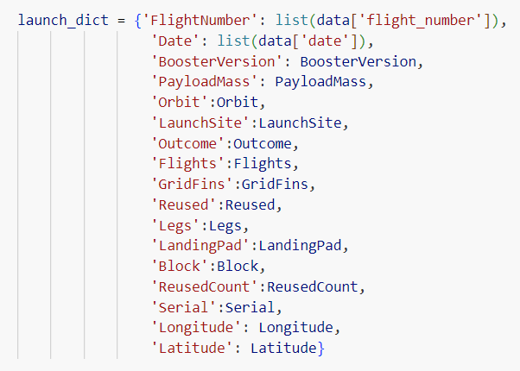
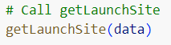
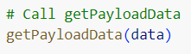
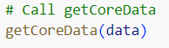
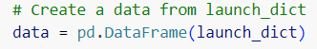
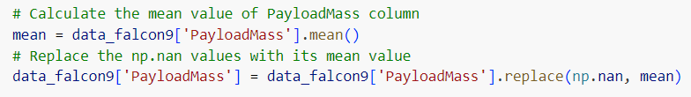
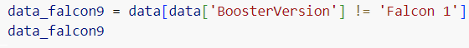
Data Collection – SpaceX API
Using the SpaceX API to retrieve data about launches, including information about the rocket used, payload delivered, launch specifications, landing specifications, and landing outcome.
1
Retrieve data using get request from SpaceX API call and convert the response to pandas dataframe
Create a dictionary of required data
Clean the data and retrieve useful information (see Appendix)
Define a list and construct the dictionary using this list
Create Pandas dataframe using the dictionary
Filter the dataframe to only Falcon 9 launches
Dealing with missing values
2
3
5
4
GitHub Link

Slide 8
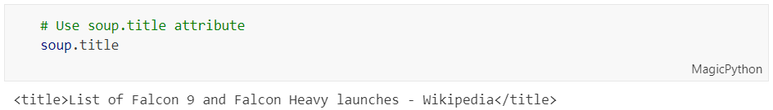
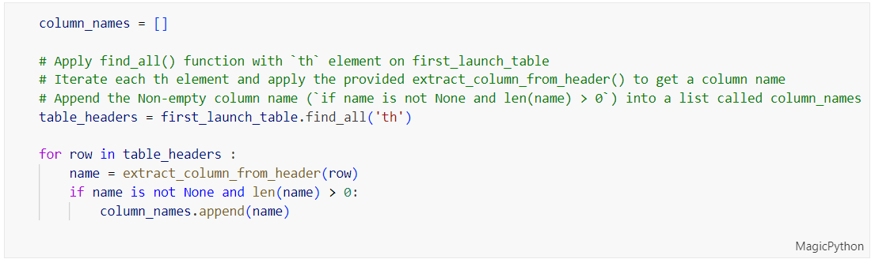
Data Collection - Scraping
Using web scraping, historical Falcon 9 launch data was gathered from the List of Falcon 9 and Falcon Heavy launches page on Wikipedia.
1
2
Using get request from url to parse the html page
Create BeautifulSoup object and extract all the tables
Use a custom method (see Appendix) to get all the column header names from the tables on the HTML page.
Create a dictionary using the column names as keys and fill the dictionary values (see Appendix)
Create the dataframe using the extracted launch_dict
3
4
5
GitHub Link

Slide 9
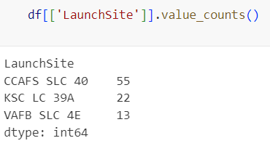

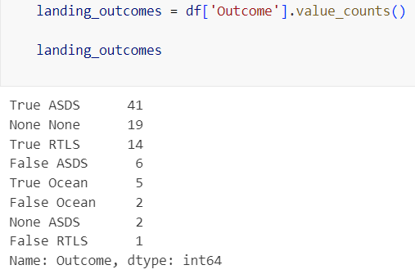
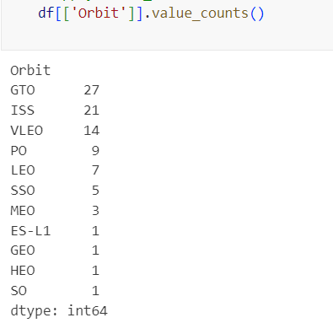
Data Wrangling
The LaunchSite column lists each of the several Space X launch facilities that are included in the SpaceX dataset.
Each launch is intended for a certain orbit, some of which are seen in the image below. The Orbit column contains the orbit type.
Initial Data Exploration:
Using the .value_counts() method to determine the following:
Number of launches on each site
Number and occurrence of each orbit
Number and occurrence of landing outcome per orbit type
GitHub Link

Slide 10
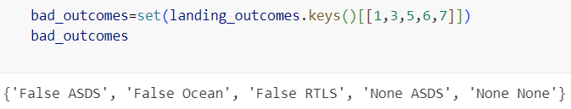
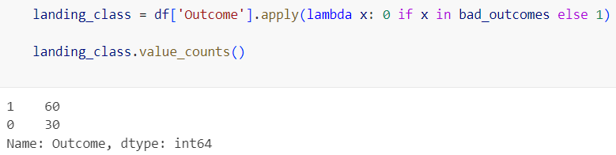
Data Wrangling
Context:
The landing outcome is shown in the Outcome column:
True Ocean – the mission outcome was successfully landed to a specific region of the ocean
False Ocean – the mission outcome was unsuccessfully landed to a specific region of the ocean.
True RTLS – the mission outcome was successfully landed to a ground pad
False RTLS – the mission outcome was unsuccessfully landed to a ground pad.
True ASDS – the mission outcome was successfully landed to a drone ship
False ASDS – the mission outcome was unsuccessfully landed to a drone ship.
None ASDS and None None – these represent a failure to land.
Data Wrangling:
It is more desirable to have a binary column, where the value is 1 or 0, signifying the success of the landing, to decide whether a booster will land successfully.
This is done by:
Defining a set of unsuccessful (bad) outcomes, bad_outcome
Creating a list, landing_class, where the element is 0 if the corresponding row in Outcome is in the set bad_outcome, otherwise, it’s 1.
Create a Class column that contains the values from the list landing_class
Export the DataFrame as a .csv file.
GitHub Link

Slide 11
EDA with Data Visualization
SCATTER PLOTS
BAR PLOTS
LINE PLOTS
Scatter plots were produced to visualize the relationships between:
Flight Number and Launch Site
Payload and Launch Site
Orbit Type and Flight Number
Payload and Orbit Type
A bar plot was produced to visualize the relationship between:
Success Rate and Orbit Type
Line plots were produced to visualize the relationships between:
Success Rate and Year (i.e. the launch success yearly trend)
Scatter plots are useful to observe relationships, or correlations, between two numeric variables.
Bar plots are used to compare a numerical value to a categorical variable. Horizontal or vertical bar charts can be used, depending on the size of the data.
Line plots contain numerical values on both axes and are generally used to show the change of a variable over time.
GitHub Link

Slide 12
EDA with SQL
To gather some information about the dataset, some SQL queries were performed.
The SQL queries performed on the data set were used to:
Display the names of the unique launch sites in the space mission
Display 5 records where launch sites begin with the string ‘CCA’
Display the total payload mass carried by boosters launched by NASA (CRS)
Display the average payload mass carried by booster version F9 v1.1
List the date when the first successful landing outcome on a ground pad was achieved
List the names of the boosters which had success on a drone ship and a payload mass between 4000 and 6000 kg
List the total number of successful and failed mission outcomes
List the names of the booster versions which have carried the maximum payload mass
List the failed landing outcomes on drone ships, their booster versions, and launch site names for 2015
Rank the count of landing outcomes (such as Failure (drone ship) or Success (ground pad)) between the date 2010-06-04 and 2017-03-20, in descending order
GitHub Link

Slide 13
Build an Interactive Map with Folium
In order to display the launch data on an interactive map, the following steps were taken:
Mark all launch sites on a map
Initialise the map using a Folium Map object
Add a folium.Circle and folium.Marker on the launch map for each launch site
Mark the success/failed launches for each site on a map
It makes sense to group launches together because they all have the same coordinates.
Assign a marker color of green for successful (class = 1) and red for unsuccessful (class = 0) before clustering them.
Add a folium.Marker to the MarkerCluster() object for each launch in order to group the launches into clusters
Create an icon as a text label and set the icon_color to the previously chosen marker_color.
Calculate the distances between a launch site to its proximities
The Lat and Long can be used to calculate the distances between places in order to investigate the proximity of launch sites.
Create a folium.Marker object to show the distance.
Draw a folium.PolyLine in order to display the distance line between two points and add this to the map.
GitHub Link

Slide 14
Build a Dashboard with Plotly Dash
To create an interactive data visualization, the following plots were added to a Plotly Dash dashboard:
The total successful launches per site – Pie Chart
Create a pie chart using px.pie()
This makes it easy to determine which sites have the most successful launches.
In order to view the success/failure ratio for a certain site, the chart could also be filtered (using a dcc.Dropdown() object).
Correlation between outcome (success or not) and payload mass (kg) – Scatter Plot
Create a pie chart using px.scatter()
A RangeSlider() object was defined to filter with respect to range of payload masses.
It can also be filtered according to the booster version.
GitHub Link

Slide 15
Predictive Analysis (Classification)
Model Development
Prepare the data
Choose a model and train the model
Model Evaluation
Obtain tuned hyper parameters(best_params)
Plot and examine the Confusion Matrix
Best Model
Review the accuracy on testing data and training data for each model
The model with highest accuracy is chosen as the best model
Pre-process and standardise
Split the data using train_test_split()
Create a GridSearchCV object with the dictionary of parameters
Train the model using the training dataset
Obtain the accuracy of the model (score and best_score)
GitHub Link

Slide 16
Results
Exploratory data analysis results
Interactive analytics demo in screenshots
Predictive analysis results

Slide 17

Section 2

Slide 18
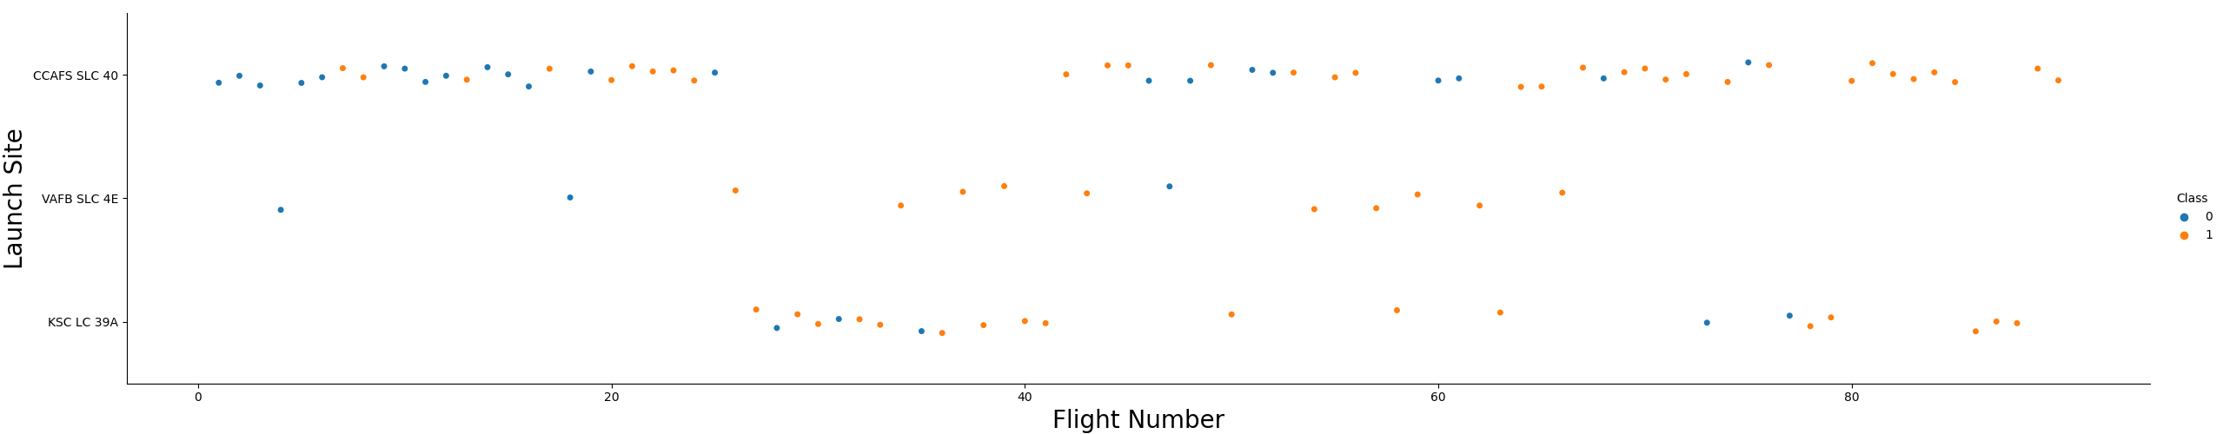
Flight Number vs. Launch Site
Scatter plot of Flight Number vs. Launch Site shows that
The success rate at a launch site rises as the number of flights rises.
Launched from CCAFS SLC 40, the majority of the early flights (flight numbers 30) were mostly unsuccessful.
This pattern, that early flights were less successful, is also demonstrated by the flights from VAFB SLC 4E.
The launches from KSC LC 39A are more successful because no early flights were launched from there.
There are significantly more successful landings (Class = 1) above a flight number of about 30.

Slide 19
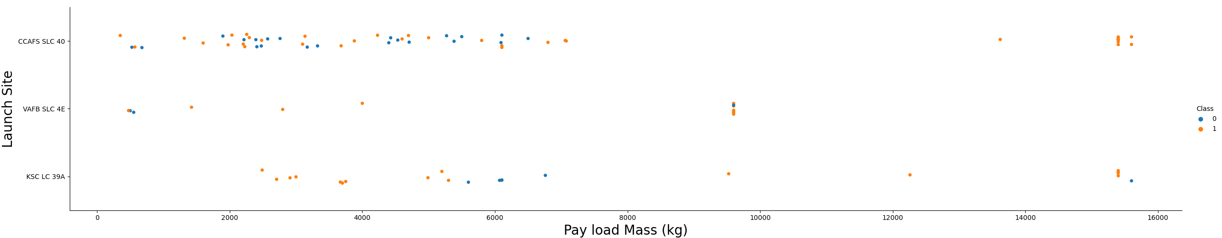
Payload vs. Launch Site
Scatter plot of Payload vs. Launch Site shows that
There are extremely few failure landings over a payload mass of about 7000 kg, but there is also much less data for these heavier launches.
For a specific launch site, there is no obvious relationship between payload mass and success rate.
All sites launched a range of payload masses, with the majority of CCAFS SLC 40's launches (apart from a few outliers) having somewhat lighter payloads.

Slide 20
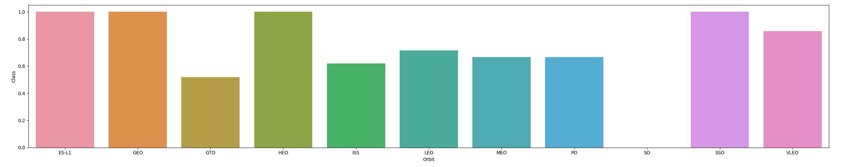
Success Rate vs. Orbit Type
Bar chart for the success rate of each orbit type
The following orbits have the highest (100%) success rate:
ES-L1 (Earth-Sun First Lagrangian Point)
GEO (Geostationary Orbit)
HEO (High Earth Orbit)
SSO (Sun-synchronous Orbit)
SO (Heliocentric Orbit) has 0% success rate

Slide 21
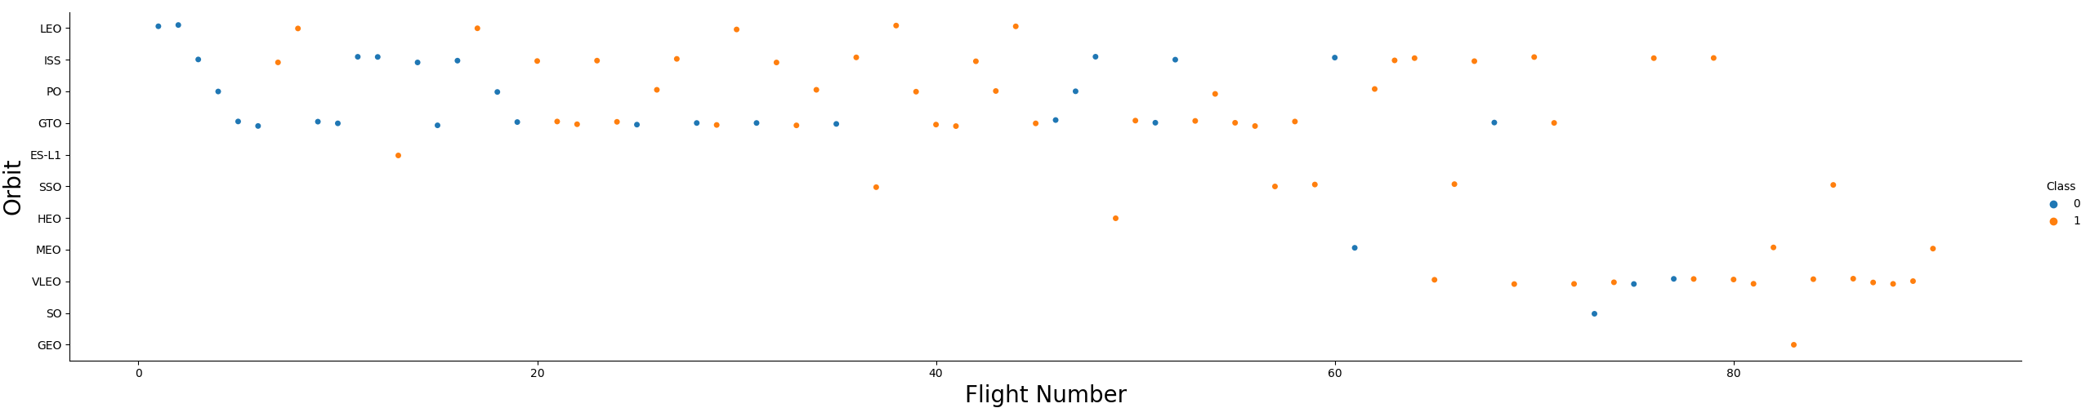
Flight Number vs. Orbit Type
Scatter plot of Flight Number vs. Orbit Type shows that
One journey into each of the three orbits — GEO, HEO, and ES-L1 can account for their 100% success rates.
With 5 successful flights, SSO's 100% success rate is even more remarkable.
The Success Rate for GTO and Flight Number have little in common.
In general, the success rate rises as Flight Number does. Extreme cases of this include LEO, where only a small percentage of flights (early launches) resulted in unsuccessful landings.

Slide 22
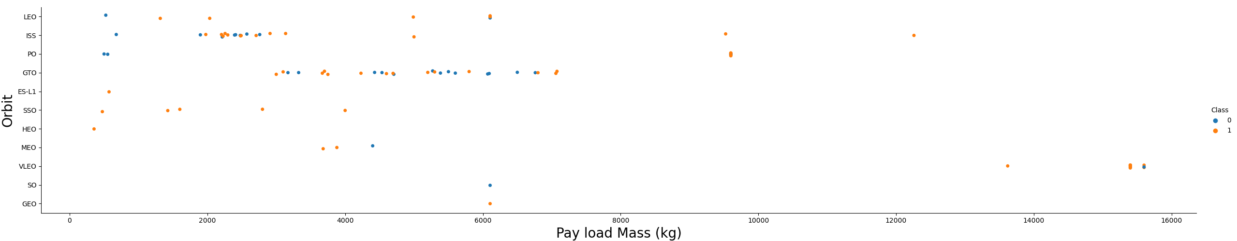
Payload vs. Orbit Type
Scatter plot of Payload vs. Orbit Type shows that
With big payloads, the following orbital types perform better:
PO (even though there are few data points)
ISS
LEO
It is unknown for GTO what the link is between payload mass and success rate.
It makes sense that heavier payloads are sent into VLEO (Very Low Earth Orbit).

Slide 23
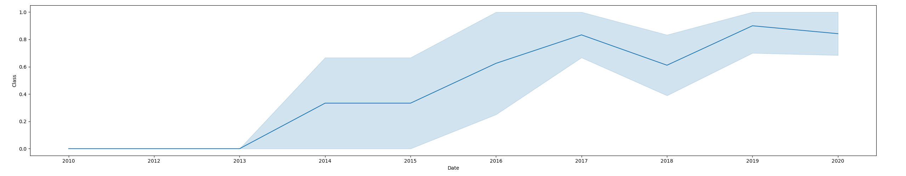
Launch Success Yearly Trend
According to the line graph of the annual average success rate, from 2010 to 2013, there were no successful landings (since the success rate was 0).
After 2013, despite slight declines in 2018 and 2020, the success rate typically rose.
After 2016, the likelihood of success was always higher than 50%.

Slide 24
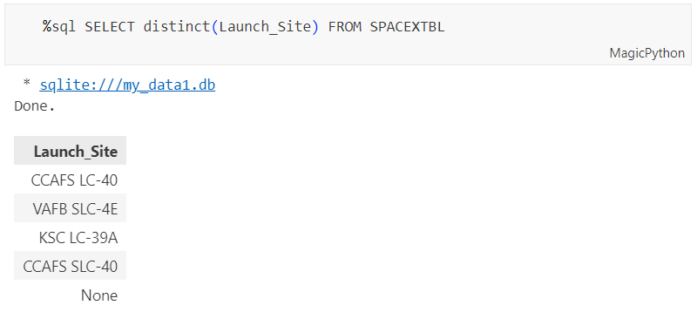
All Launch Site Names
Find the names of the unique launch sites
The word UNIQUE returns only unique values from the LAUNCH_SITE column of the SPACEXTBL table.

Slide 25
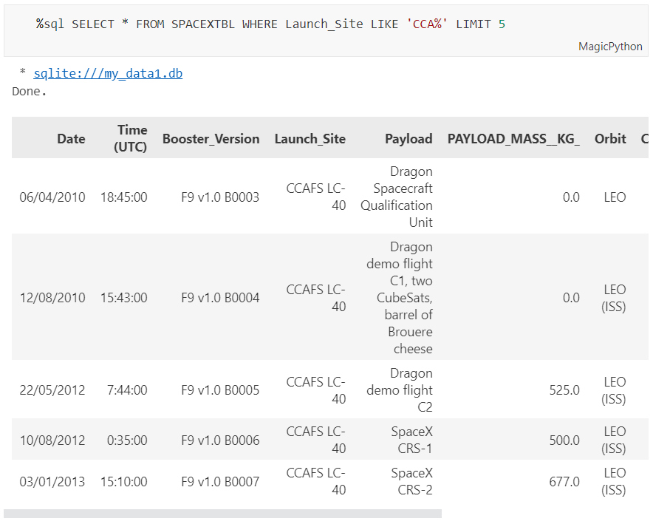
Launch Site Names Begin with 'CCA'
Find 5 records where launch sites begin with `CCA`
LIMIT 5 restricts the results to 5, LIKE keyword with wildcard ‘CCA%’ will find the results Launch_Site starting with CCA.

Slide 26
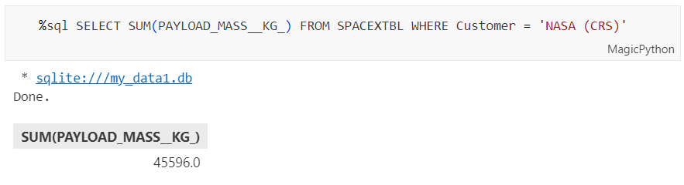
Total Payload Mass
Calculate the total payload carried by boosters from NASA
The LAUNCH column is totaled using the SUM keyword, and the SUM keyword (and the corresponding condition) limits the results to boosters from NASA (CRS).

Slide 27
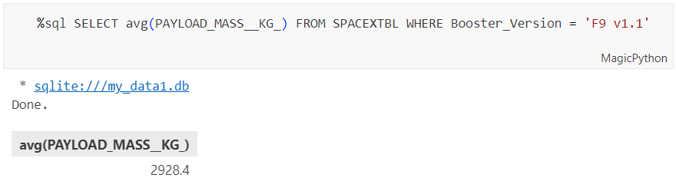
Average Payload Mass by F9 v1.1
Calculate the average payload mass carried by booster version F9 v1.1
The PAYLOAD_MASS__KG_ column is averaged using the AVG keyword, and the WHERE keyword (and the corresponding condition) limits the results to only the F9 v1.1 booster version.

Slide 28
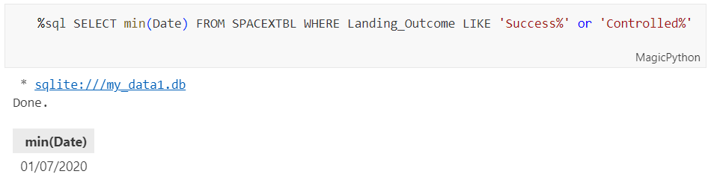
First Successful Ground Landing Date
Find the dates of the first successful landing outcome on ground pad
The MIN keyword is used to determine the earliest date in the DATE column, and the WHERE keyword (together with its associated condition) narrows the search to only the successful landings at the ground pad.

Slide 29
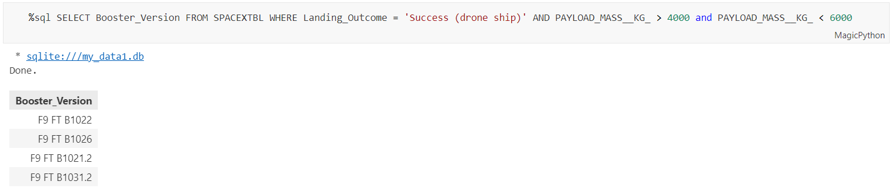
Successful Drone Ship Landing with Payload between 4000 and 6000
List the names of boosters which have successfully landed on drone ship and had payload mass greater than 4000 but less than 6000
Because the AND keyword is also used, the WHERE keyword is used to narrow the search to only those results that meet both parameters. With the BETWEEN keyword, you can pick from a range of 4000 < x < 6000 possible values.

Slide 30
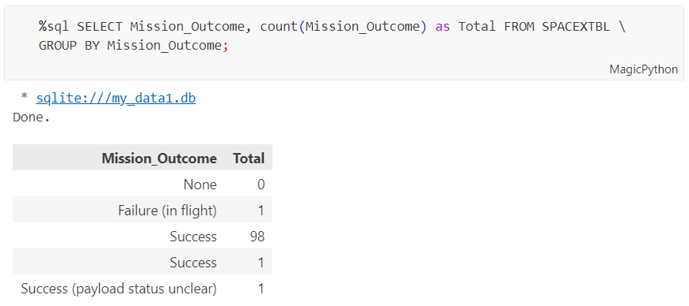
Total Number of Successful and Failure Mission Outcomes
Calculate the total number of successful and failure mission outcomes
You may get a count of all mission results by using the COUNT keyword, and you can sort those results by mission result type using the GROUPBY keyword.

Slide 31
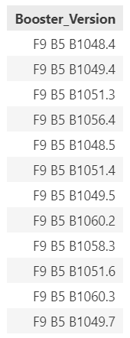
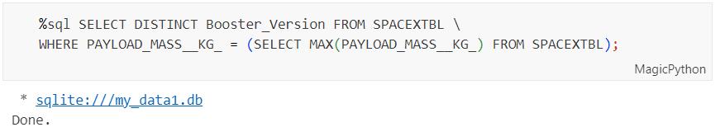
Boosters Carried Maximum Payload
List the names of the booster which have carried the maximum payload mass
This makes use of a subquery. The WHERE condition relies on the maximum payload, which is found by the SELECT expression enclosed in brackets. Finally, unique versions of boosters are retrieved using the DISTINCT keyword.

Slide 32
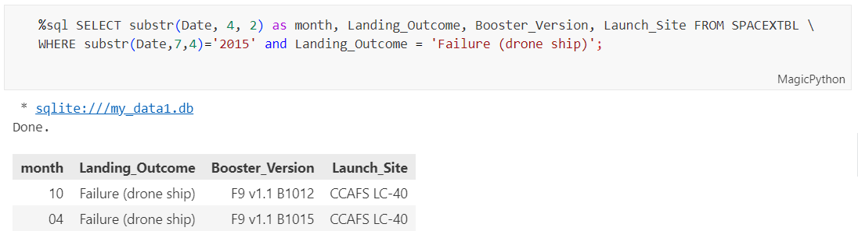
2015 Launch Records
List the failed landing_outcomes in drone ship, their booster versions, and launch site names for in year 2015
With the WHERE clause, we can restrict the output to only landing attempts that were unsuccessful AND to 2015 as the search year.

Slide 33
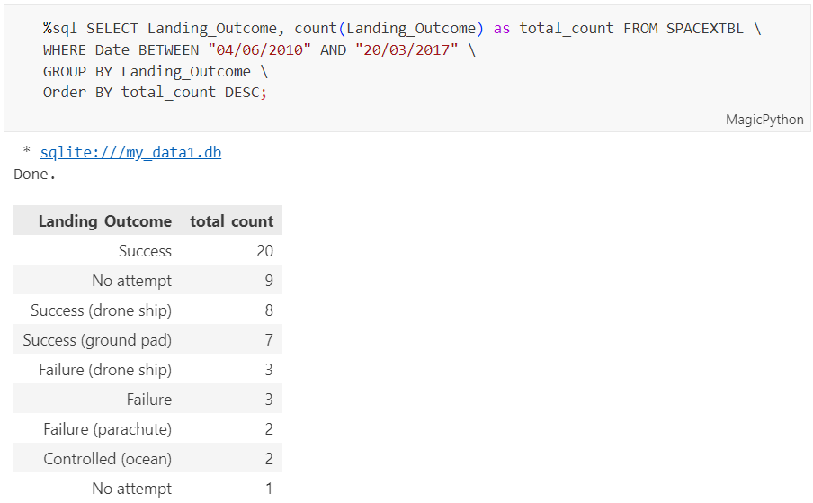
Rank Landing Outcomes Between 2010-06-04 and 2017-03-20
Rank the count of landing outcomes (such as Failure (drone ship) or Success (ground pad)) between the date 2010-06-04 and 2017-03-20, in descending order
When combined with BETWEEN, the WHERE keyword narrows search results to just those that fall within the range of the supplied dates. DESC is used to specify a descending order when using the keywords GROUP BY and ORDER BY to sort the results.

Slide 34

Section 3

Slide 35
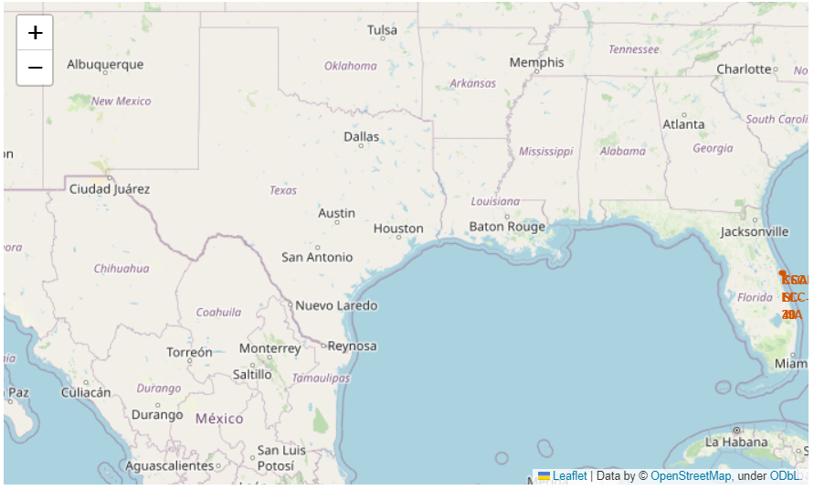
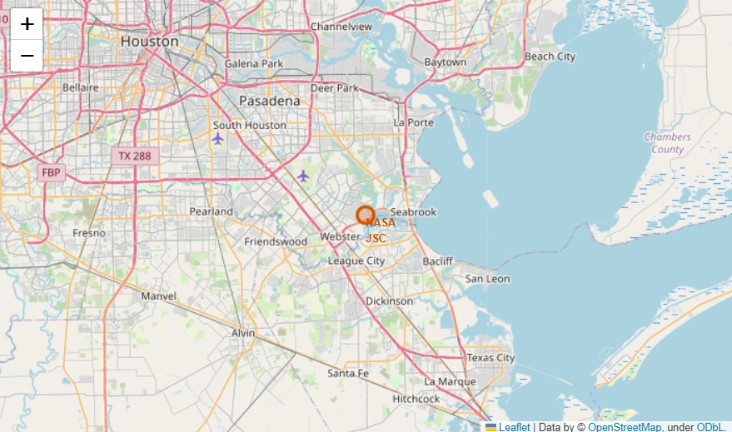
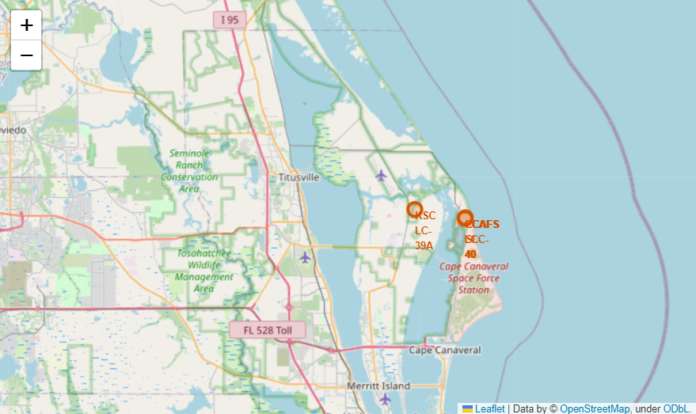
All launch sites on the map
Table of all launch sites
 | Launch Site | Lat | Long
0 | CCAFS LC-40 | 28.562302 | -80.577356
1 | CCAFS SLC-40 | 28.563197 | -80.576820
2 | KSC LC-39A | 28.573255 | -80.646895
3 | VAFB SLC-4E | 34.632834 | -120.610745

Slide 36

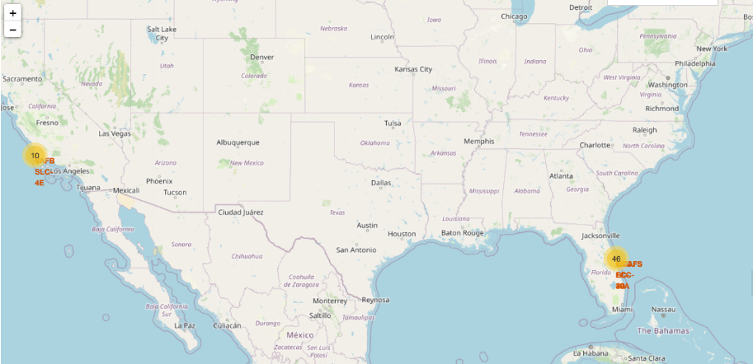
Success/Failed launches for each site
Launches have been grouped into clusters, and annotated with green icons for successful launches, and red icons for failed launches.

Slide 37
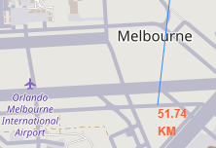
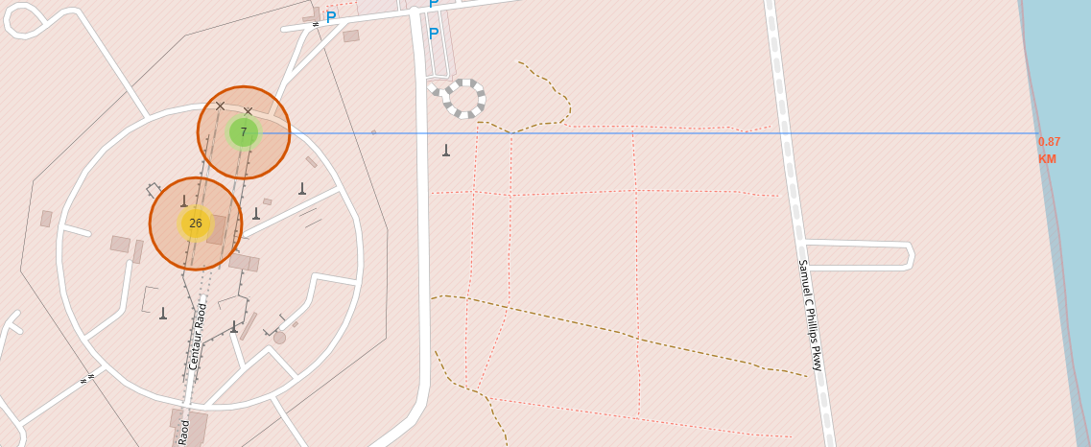
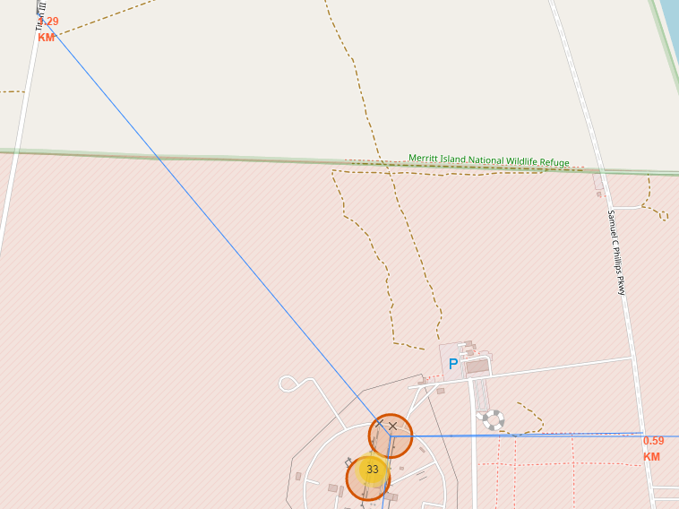
<Folium Map Screenshot 3>
Using the CCAFS SLC-40 launch site as an example site, we can understand more about the placement of launch sites.
Are launch sites in close proximity to railways?
YES. The coastline is only 0.87 km due East.
Are launch sites in close proximity to highways?
YES. The nearest highway is only 0.59km away.
Are launch sites in close proximity to railways?
YES. The nearest railway is only 1.29 km away.
Do launch sites keep certain distance away from cities?
YES. The nearest city is 51.74 km away.

Slide 38

Section 4

Slide 39

launch success count for all sites
The launch site KSC LC-39 A had the most successful launches, with 41.7% of the total successful launches.

Slide 40

Pie chart for the launch site with highest launch success ratio
The launch site KSC LC-39 A also had the highest rate of successful launches, with a 76.9% success rate.

Slide 41

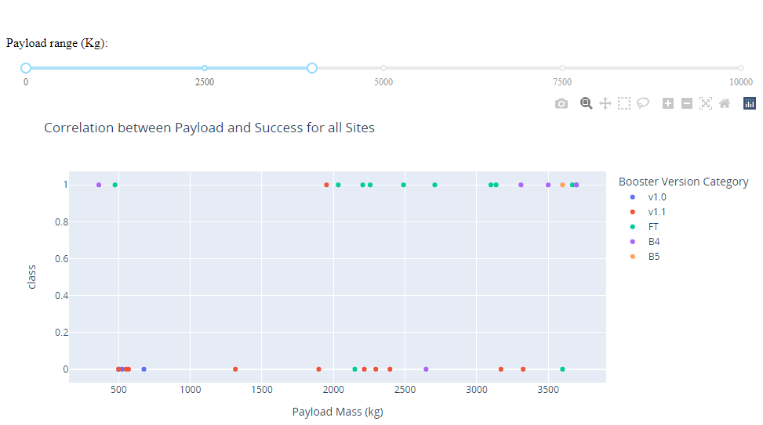
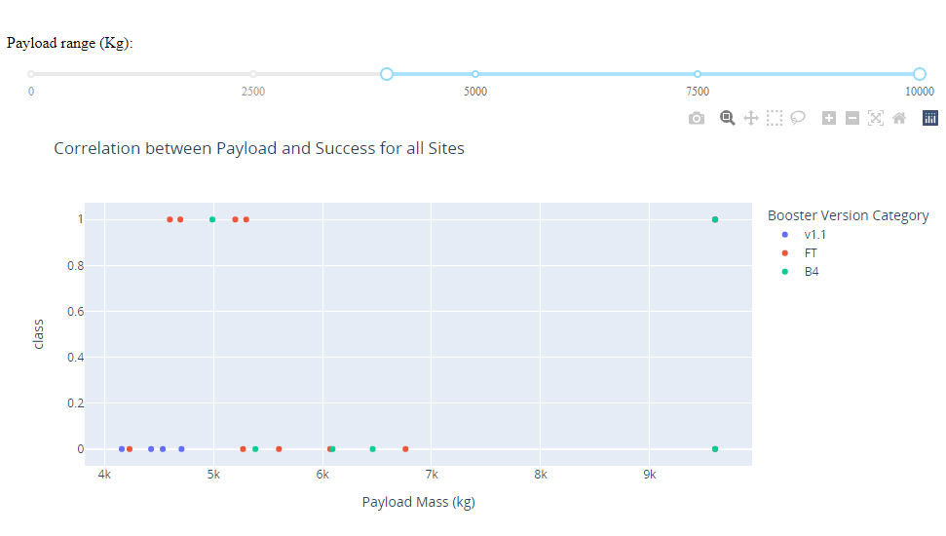
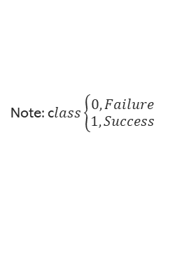
Launch Outcome VS. Payload scatter plot for all sites
Launch Outcome VS. Payload scatter plot for all sites
1
1
Low payloads
2
Massive payloads
2
Plotting the launch outcome vs. payload for all sites shows a gap around 4000 kg, so it makes sense to split the data into 2 ranges:
0 – 4000 kg (low payloads)
4000 – 10000 kg (massive payloads)
From these 2 plots, it can be shown that the success for massive payloads is lower than that for low payloads.
It is also worth noting that some booster types (v1.0 and B5) have not been launched with massive payloads.
Note: c$lass\left\{\begin{aligned}0, Failure \\ 1, Success\end{aligned}\right.$

Slide 42

Section 5

Slide 43
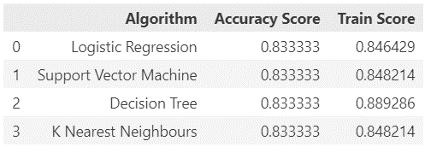
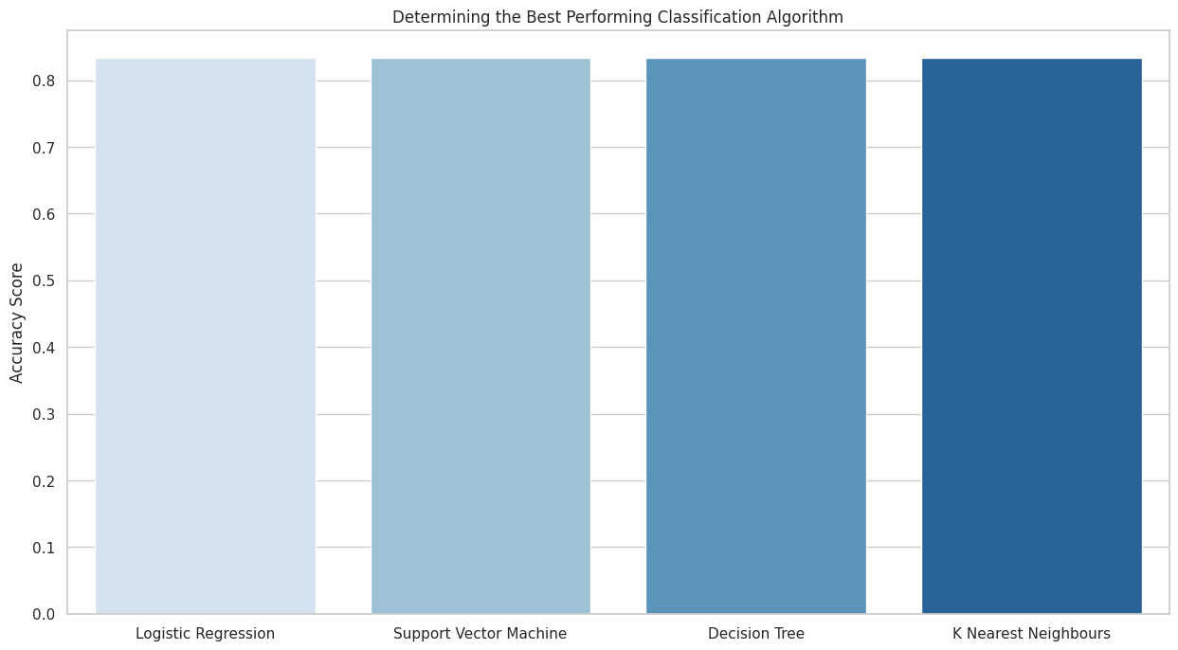
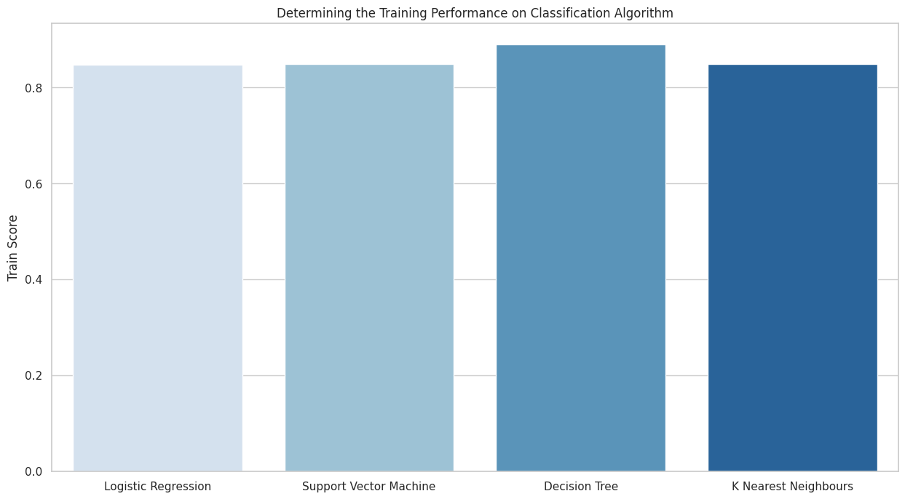
Classification Accuracy
The following outcome is obtained by plotting the Accuracy Score and Best Score for each classification algorithm:
The classification accuracy is highest with the Decision Tree model.
The Accuracy Score is 83.33%
The Best Score is 88.93%

Slide 44

Confusion Matrix
The Decision Tree model, with an accuracy of 83.33%, is the best-performing classification model, as was previously demonstrated.
The confusion matrix, which displays 3 out of a total of 18 results that were mistakenly categorized (a false positive, shown in the top-right corner), explains this.
The remaining 15 results (3 didn't land, 12 did) are accurately categorized.

Slide 45
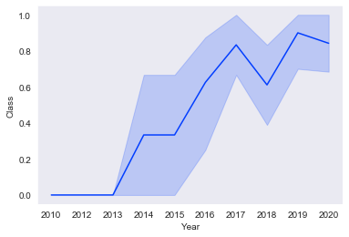
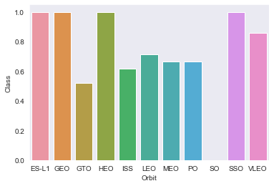
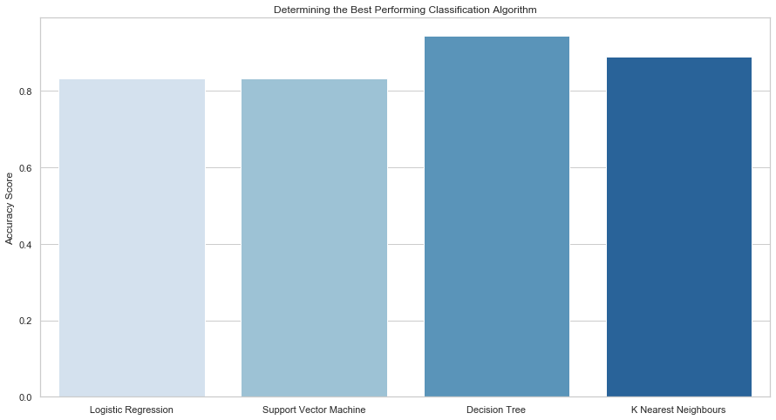

Conclusions
As the number of flights increases, the rate of success at a launch site increases, with most early flights being unsuccessful. i.e., with more experience, the success rate increases.
Between 2010 and 2013, all landings were unsuccessful (as the success rate is 0).
After 2013, the success rate generally increased, despite small dips in 2018 and 2020.
After 2016, there was always a greater than 50% chance of success.
Orbit types ES-L1, GEO, HEO, and SSO, have the highest (100%) success rate.
The 100% success rate of GEO, HEO, and ES-L1 orbits can be explained by only having 1 flight into the respective orbits.
The 100% success rate in SSO is more impressive, with 5 successful flights.
The orbit types PO, ISS, and LEO, have more success with heavy payloads:
VLEO (Very Low Earth Orbit) launches are associated with heavier payloads, which makes intuitive sense.
The launch site KSC LC-39 A had the most successful launches, with 41.7% of the total successful launches, and also the highest rate of successful launches, with a 76.9% success rate.
The success for massive payloads (over 4000kg) is lower than that for low payloads.
The best performing classification model is the Decision Tree model, with an accuracy of 83.33%.

Slide 46

Appendix – Data Collection – SpaceX API
Custom code to clean the data

Slide 47



Appendix – Data Collection – SpaceX API
Custom functions to retrieve the data

Slide 48

Appendix – Data Collection – Scraping
Creating a launch_dict
extracted_row = 0
# Extract each table
for table_number, table in enumerate(
soup.find_all('table', "wikitable plainrowheaders collapsible")):
# get table row
for rows in table.find_all("tr"):
# check to see if first table heading is as number corresponding to launch a number
if rows.th:
if rows.th.string:
flight_number = rows.th.string.strip()
flag = flight_number.isdigit()
else:
flag = False
# get table element
row = rows.find_all('td')
# if it is number save cells in a dictonary
if flag:
extracted_row += 1
# Flight Number value
# TODO: Append the flight_number into launch_dict with key `Flight No.`
launch_dict['Flight No.'].append(flight_number)
# print(flight_number)
datatimelist = date_time(row[0])
# Date value
# TODO: Append the date into launch_dict with key `Date`
date = datatimelist[0].strip(',')
launch_dict['Date'].append(date)
# print(date)
# Time value
# TODO: Append the time into launch_dict with key `Time`
time = datatimelist[1]
launch_dict['Time'].append(time)
# print(time)
# Booster version
# TODO: Append the bv into launch_dict with key `Version Booster`
bv = booster_version(row[1])
if not(bv):
bv = row[1].a.string
# print(bv)
launch_dict['Version Booster'].append(bv)
# Launch Site
# TODO: Append the bv into launch_dict with key `Launch site`
launch_site = row[2].a.string
launch_dict['Launch site'].append(launch_site)
# print(launch_site)
# Payload
# TODO: Append the payload into launch_dict with key `Payload`
payload = row[3].a.string
launch_dict['Payload'].append(payload)
# print(payload)
# Payload Mass
# TODO: Append the payload_mass into launch_dict with key `Payload mass`
payload_mass = get_mass(row[4])
launch_dict['Payload mass'].append(payload_mass)
# print(payload)
# Orbit
# TODO: Append the orbit into launch_dict with key `Orbit`
orbit = row[5].a.string
launch_dict['Orbit'].append(orbit)
# print(orbit)
# Customer
# TODO: Append the customer into launch_dict with key `Customer`
# print(row[6].a, '<- row[6]')
try:
customer = row[6].a.string
except AttributeError:
customer = ''
launch_dict['Customer'].append(customer)
# print(customer)
# Launch outcome
# TODO: Append the launch_outcome into launch_dict with key `Launch outcome`
launch_outcome = list(row[7].strings)[0]
launch_dict['Launch outcome'].append(launch_outcome)
# print(launch_outcome)
# Booster landing
# TODO: Append the launch_outcome into launch_dict with key `Booster landing`
booster_landing = landing_status(row[8])
launch_dict['Booster landing'].append(booster_landing)
# print(booster_landing)

Slide 49


Appendix – Data Collection – Scraping
Custom functions to extract the data

Slide 50


